Slide 1
Overview of Results from Training Reinforcement Learning Agents
Prepared by Cubic | Austin – John Lamb
Everglades Phase 2 – SOW B – Item 2.1.b.b

Slide 2
Contents
Reward functions
Policy Gradient performance
Proximal Policy Optimization performance
High-level training observations
Suggestions for improving game play for more user engagement

Slide 3
Reward Functions
Two options for rewarding an agent:
Using the in game score
Using a simple 1, 0, -1 for wins, ties, and loses respectively
Calculating game score:
1 point per unit
100 points per captured node (bases are worth 500 points each)
1000 points for capturing the opponent’s base
Implemented naively, the game score proved to be a bad tool for learning
Using the simple 1, 0, -1 reward function proved to be better for learning

Slide 4
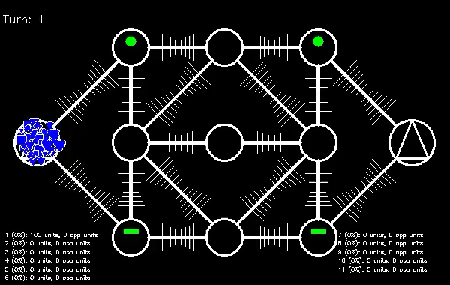
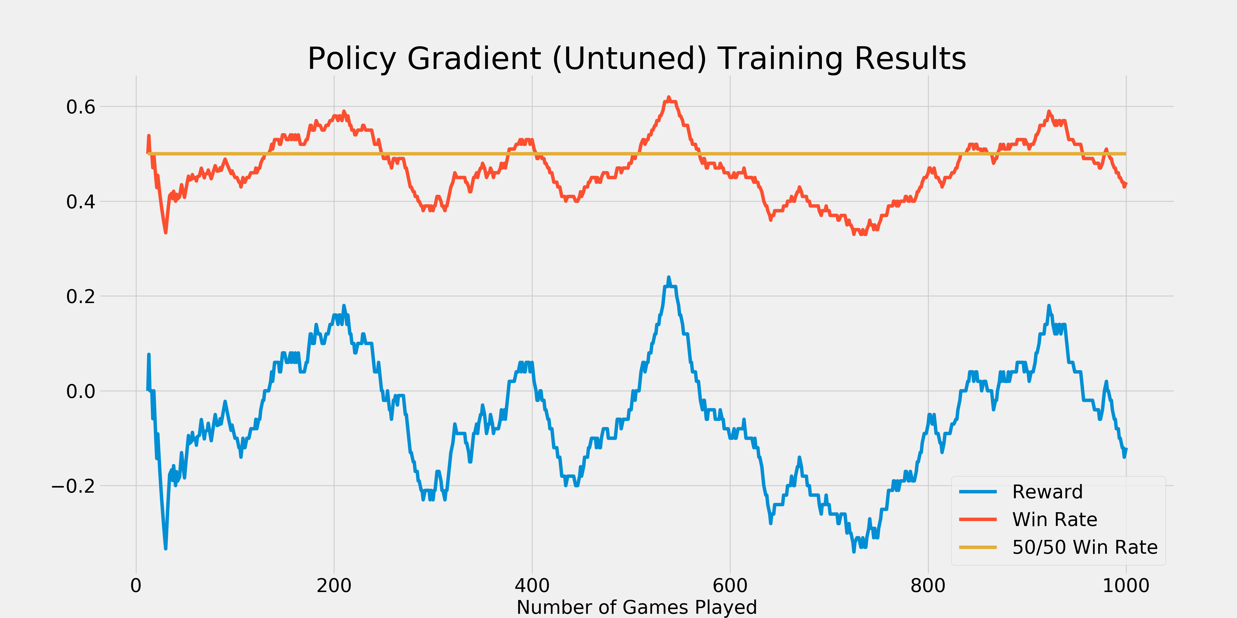
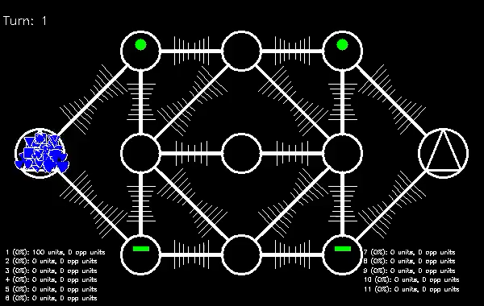
Algorithmic Approaches – Policy Gradient
Policy Gradient (PG) is a standard baseline algorithm
PG was used to train an agent over 1,000 games against an opponent who took random actions
PG’s peak performance occurred after playing ~525 games with a win rate of 62%
Example of initial game play
Example of game play after 525 games

Slide 5
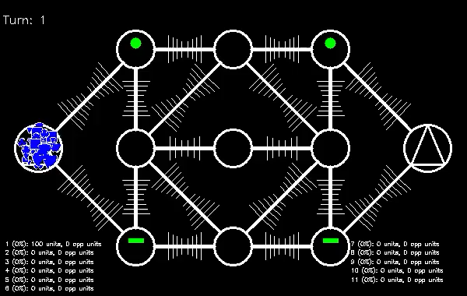
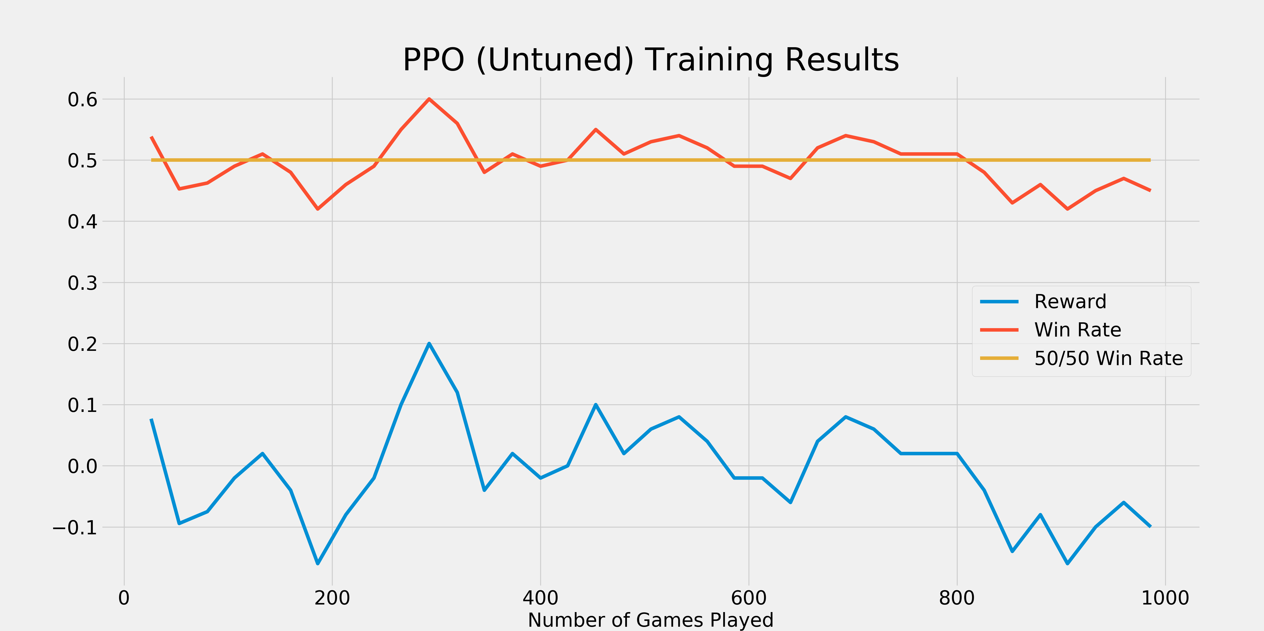
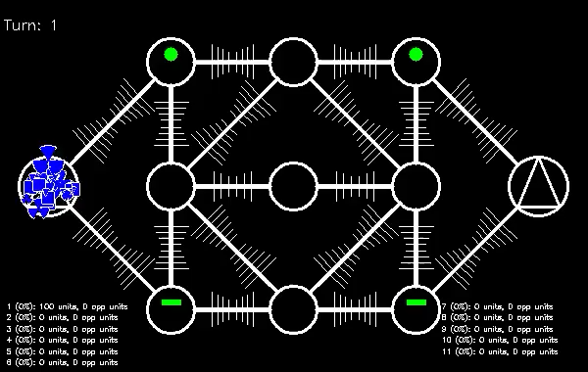
Algorithmic Approaches – PPO
Proximal Policy Optimization (PPO) is Open AI’s baseline algorithm for most RL tasks
PPO was used to train an agent over 1,000 games against a random agent
PPO’s peak performance occurred at ~300 games played with a win rate of 60%
Example of initial game play
Example of game play after 525 games

Slide 6
Observations from Training
The opponent’s strategy greatly influences the trained agent’s strategy and success
Low barrier to entry: Play against an opponent that takes random actions
More difficult: Play against a mix of opponents that have varying strategies (aggressive, defensive, etc.)
Not tried: Self-play, have the agent play against itself
As delivered, the docker-compose setup makes this difficult to implement
If prioritized, this barrier can be removed in the future

Slide 7
Options to Improve Agent Performance
The current game rules do not make high win rates easy to achieve
Exposing the agent to a diverse set of strategies should improve performance
Tuning the hyperparamters should squeeze more performance out of the agents
The game makes it too challenging to identify the opponent’s strategy
Reduce fog of war
The agent can’t react fast enough
Reduce travel time between nodes
Larger maps, varying group sizes, varying unit counts, tweaking node defense bonuses could all lead to a richer environment for RL agents

